Slide 1
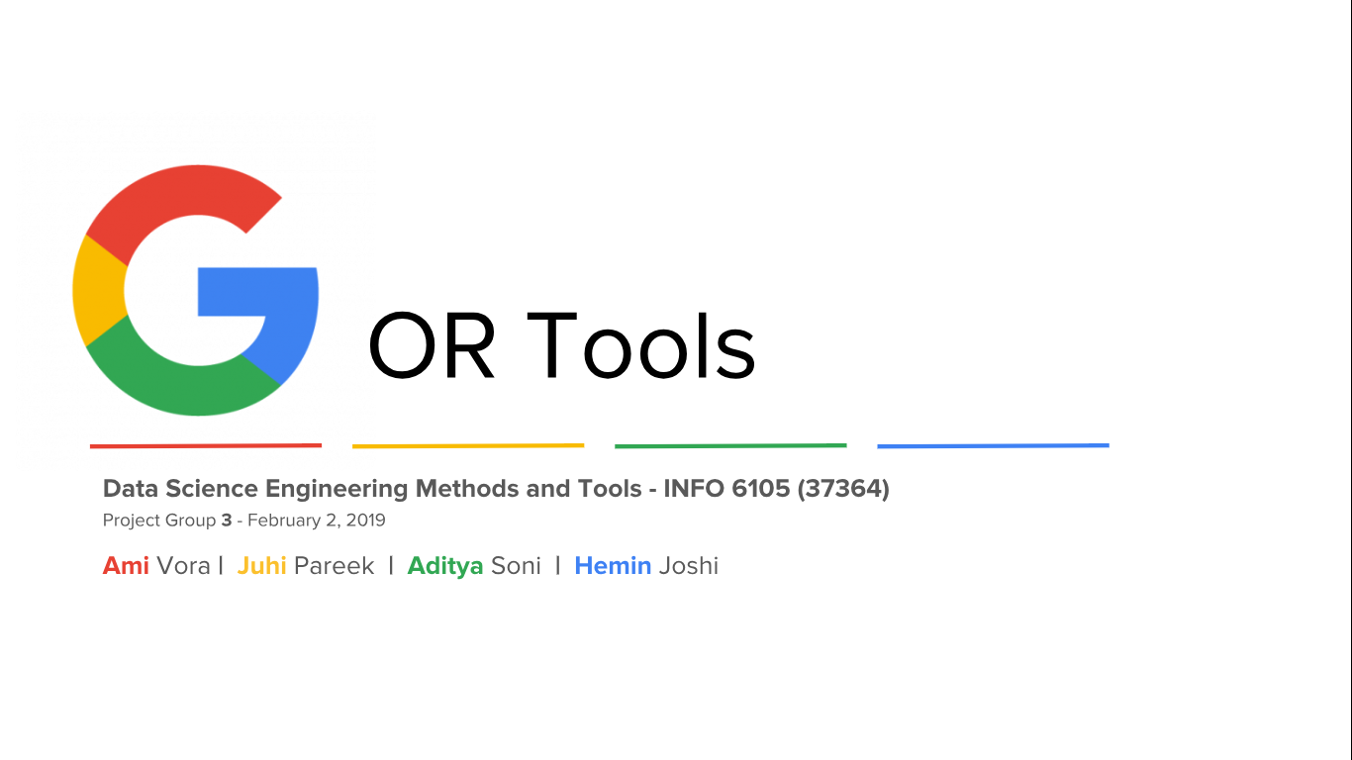

Slide 2
LINEAR OPTIMIZATION
CONSTRAINT OPTIMIZATION
INTEGER OPTIMIZATION
ROUTING

Slide 3

Ami Vora
vora.am@husky.neu.edu

Slide 4
Bin Packing

Slide 5
Basic idea of Optimization algorithms
In each phase, it makes the best choice based on the current partial solution and the performance metric.
No future consequences are considered when making decisions.
Usually it will not go back to change the previous choices.

Slide 6
What is Bin packing problem
In the bin packing problem, objects of different volumes must be packed into a finite number of bins or containers each of volume V in a way that minimizes the number of bins used.
01
The objects have weights (or volumes), and each container has a capacity, which is the total weight (or volume) the container can hold.
02
There are many variations of this problem, such as 2D packing, linear packing, packing by weight, packing by cost, and so on.
03

Slide 7
applications
Filling up containers
Loading trucks with weight capacity constraints
Creating file backups in media

Slide 8
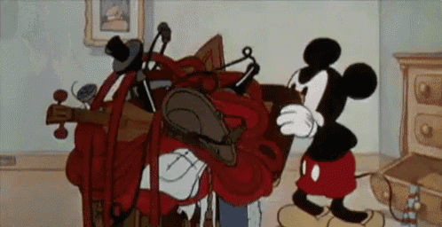
One of the most common bin packing problems is knapsacks

Slide 9
Knapsack Problem
A knapsack is a bag-packing problem, in which the goal is to maximize the total value of items in (typically) a single bin.
Given a set of items, each with a weight and a value, determine the number of each item to include in a collection so that the total weight is less than or equal to a given limit and the total value is as large as possible.

Slide 10
Constraints
Sum of the weights of this subset is smaller than or equal to the total capacity of knapsack
You cannot break an item, either pick the complete item, or don’t pick it (0-1 property)

Slide 11
Example
Weight[ ]={10,20,30}
Value[ ]={60,100,120}
Total Capacity of Knapsack=50

Slide 12
Weight and it’s corresponding value
Weight=10 Value=60
1
Weight=20 Value=100
2
Weight=30 Value=120
3

Slide 13
possibilities
Weight(10+20) Value(60+100)
1
Weight(10+30) Value(60+120)
2
Weight(20+30) Value(100+120)
3
Weight(10+20+30) Value(60+100+120)
4

Slide 14


Check which possibilities satisfy the constraints
Weight(30), Value(160)
Weight(40), Value(180)
Weight(50), Value(220)
Weight(60), Value(280)

Slide 15
Why?
Weight(60), Value(280) is not a possible solution as the total weight here is 60 which exceeds the capacity of knapsack which is 50.
It violates the constraint.
We are now left with three possible solutions:
Weight(30), Value(160)
Weight(40), Value(180)
Weight(50), Value(220)

Slide 16
Choose the optimal solution
Choose the solution with maximum value.
Weight(50), Value(220) is the optimal solution to the given problem.
It satisfies all the constraints and gives the best possible solution to our knapsack problem.

Slide 17
Knapsack application

Slide 18


Slide 19

Aditya Soni
soni.ad@husky.neu.edu

Slide 20

NETWORK FLOWS

Slide 21
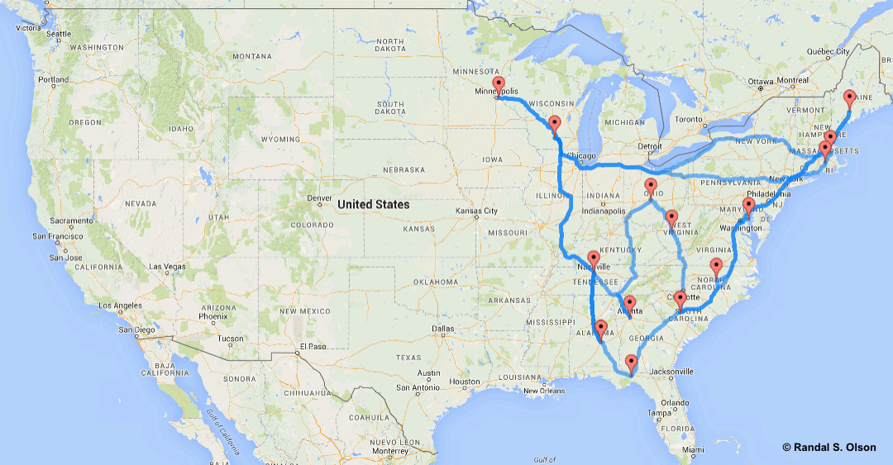

Transport system in uSA

Slide 22

CONSTRAINTS
Capacity: Maximum amount that can be transported at a fixed period of time.
Cost: We will discuss this further in min cost flow case for the transportation system.

Slide 23
Finding an Optimal Solution
We plan to transport materials from Boston (source) to Lowell(Sink) via different cities of network to find the maximum flow of materials between the two cities.
The max flow problem is to find a flow for which the sum of the flow amounts for the entire network is as large as possible.

Slide 24
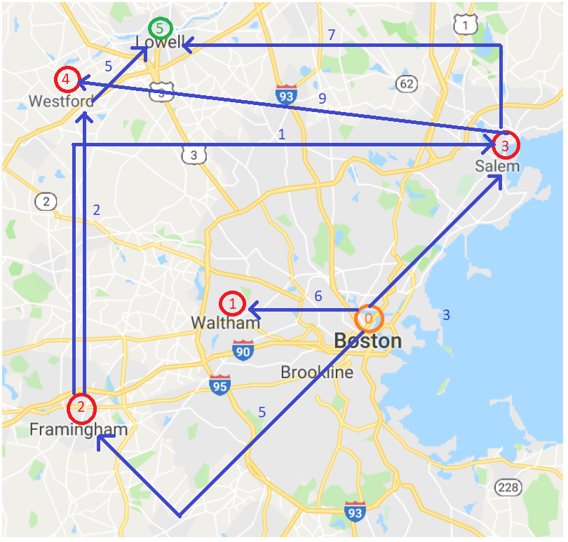
Maximum flow problem
Legends:
Orange: Source Node
Green: Sink Node
Blue: Max capacity

Slide 25
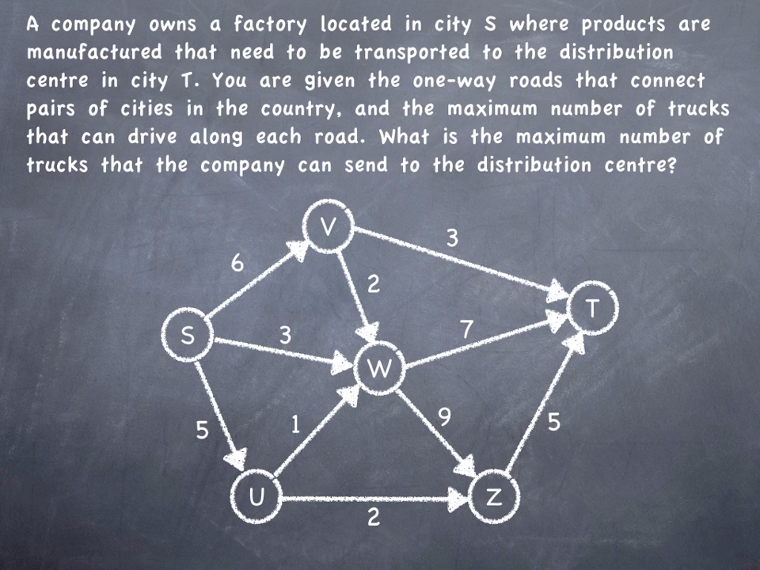
Maximum flow problem

Slide 26
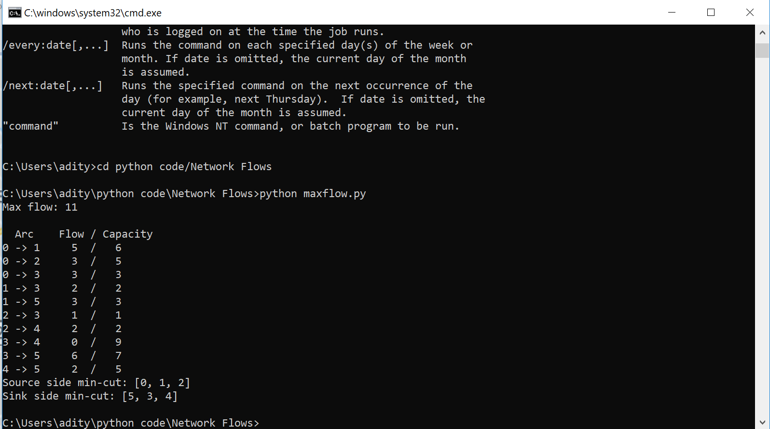
PYTHON CODE

Slide 27
Minimum Cost Flow Problem
The min cost flow problem also has special nodes, called supply nodes or demand nodes, which are similar to the source and sink in the max flow problem. Material is transported from supply nodes to demand nodes.
At a supply node, a positive amount the supply is added to the flow. A supply could represent production at that node.
At a demand node, a negative amount the demand is taken away from the flow. A demand could represent consumption at that node.
Represented in the figure as (Capacity, Cost) and nodes have values for supply and demand.

Slide 28
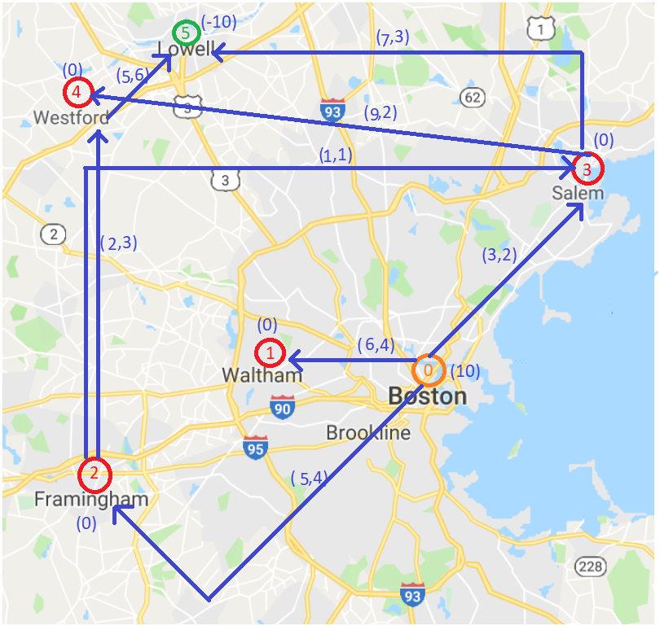
Minimum Cost Flow Problem
Note: At each node, the total flow leading out of the node minus the total flow leading in to the node equals the supply (or demand) at that node.

Slide 29
OPTIMAL SOLUTION
Optimal solution for this would be to first find out the maximum flow from the arcs and multiply them by their individual costs which results in cost between two nodes.
After that this cost is added to all the costs possible between the nodes and the resultant becomes the min cost possible while providing a maximum flow.

Slide 30
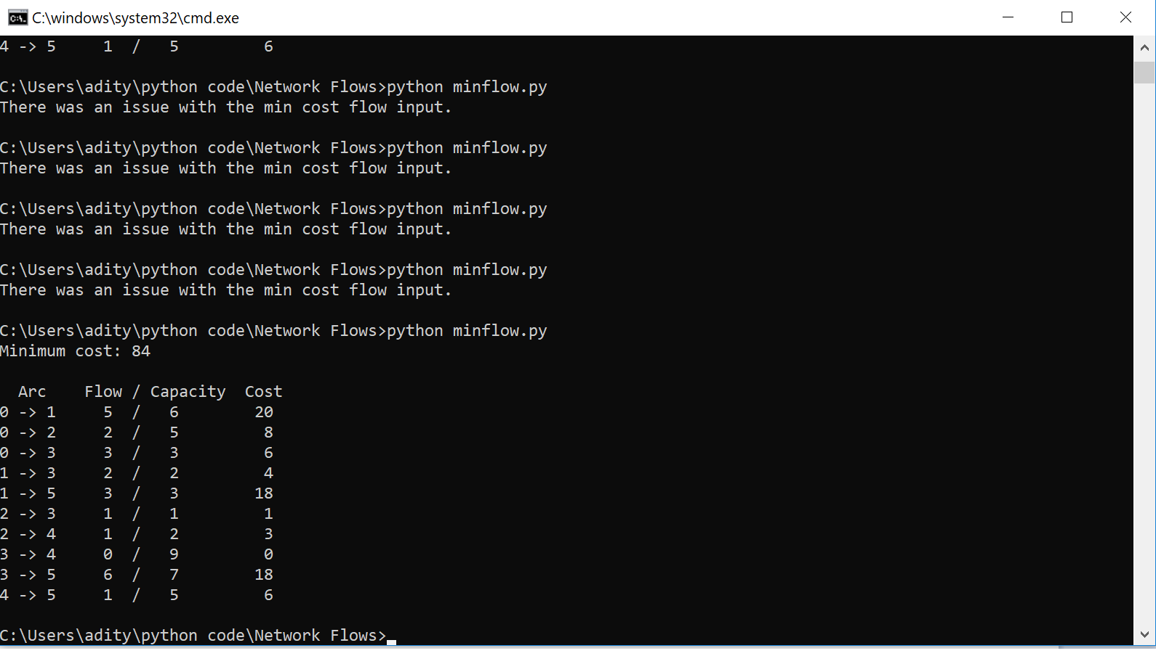
Python code

Slide 31

Hemin Joshi
joshi.he@husky.neu.edu

Slide 32



Slide 33


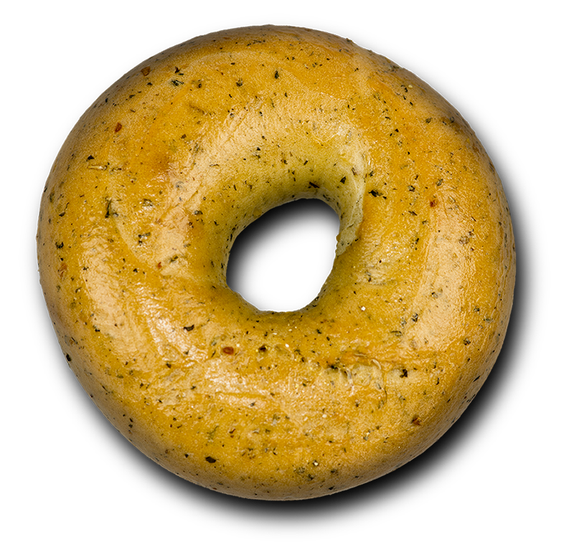

Slide 34
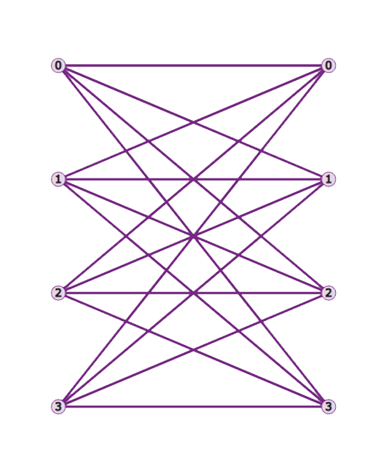
Passenger – Time – Driver
Girl – Compatibility – Boy

Slide 35

Juhi Pareek
pareek.j@husky.neu.edu

Slide 36

SCHEDULING
This Photo by Unknown author is licensed under CC BY.

Slide 37
OVERVIEW
Method by which work is assigned to resources that complete the work.
Goal :
All resources are kept busy
Multiple users can share system resources effectively
Target quality of service is achieved

Slide 38
Real world APPLICATIONs
Scheduling employees for shifts
Scheduling movies in a theatre
Time tables
Appliance Scheduling Optimization in Smart Home Networks
Scheduling manufacturing processes in a factory

Slide 39
Employee scheduling
Consider a nurse scheduling problem :
No of nurses : 4
No of days to be scheduled : 3
No of shifts per day : 3

Slide 40
Employee scheduling
Constraints
Minimum no of shifts assigned to each nurse = 2
No of shifts assigned to each nurse a day <=1

Slide 41
EMPLOYEE SCHEDULING
Total number of possible assignments :
= (4*3^3) * (3!) * (2^3)
= 5184

Slide 42
EMPLOYEE SCHEDULING
Shift request
[ [ 1, 0, 0] , [ 0, 0, 0] , [ 0, 0, 1] ]
[ [ 0, 0, 0] , [ 0, 1, 0] , [ 0, 1, 0] ]
[ [ 0, 0, 1] , [ 1, 0, 0] , [ 0, 0, 0] ]

Slide 43
JOB SHOP Problem
Multiple jobs to be scheduled on multiple machines in a given order
Goal : Minimize the length of schedule

Slide 44
Job SHOP Problem (constraints)
No task for a job can be started until the previous task for that job is completed.
A machine can only work on one task at a time.
A task, once started, must run to completion.

Slide 45
Job shop problem
Job 0 | M0 (3) M1 (2) M2 (2)
Job 1 | M0 (2) M2 (1) M1 (4)
Job 2 | M1 (4) M2 (3)

Slide 46
JOB SHOP PROBLem
Rule
Choose job with smallest processing time.
Don't keep a machine idle if a job is waiting

Slide 47
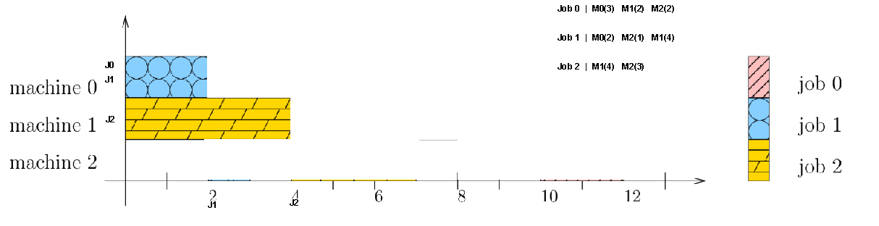
JOB SHOP PrOBLEM

Slide 48
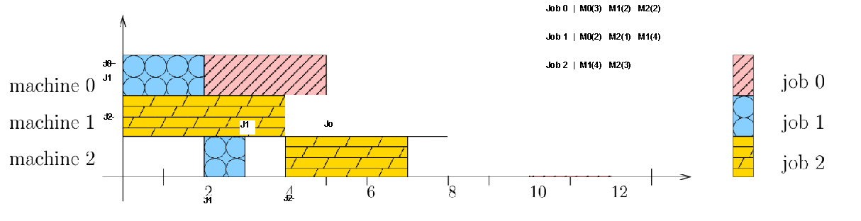
JOB SHOP PrOBLEM

Slide 49
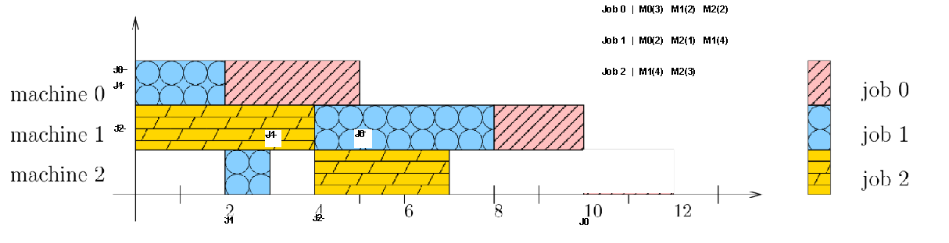
JOB SHOP PrOBLEM

Slide 50
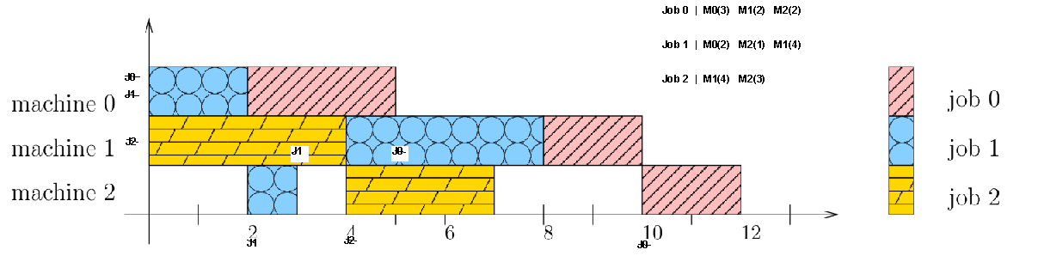
JOB SHOP PrOBLEM

Slide 51
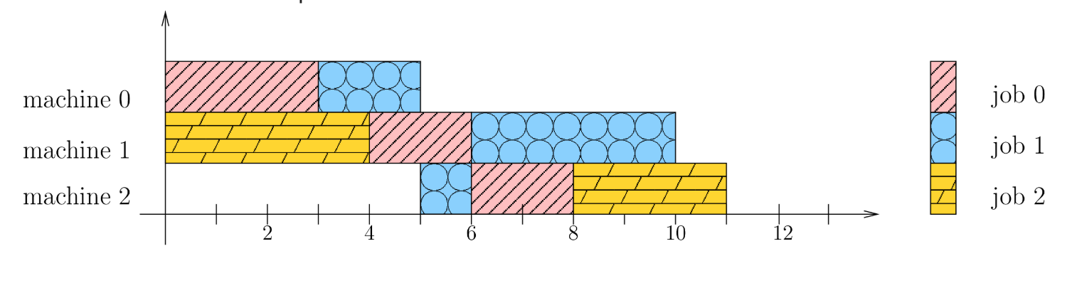
JOB SHOP PROBLEM
Optimal Solution :

